Slide 1
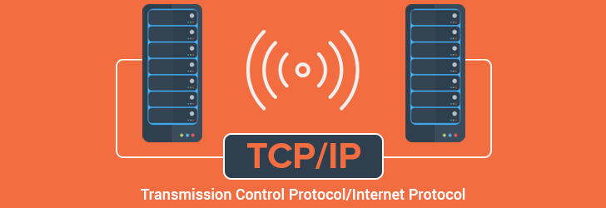
Name – Taniya Chakraborty Stream – CSE Year – 3rd Semester – 6th
Roll No. – 16800117006 Subject – Computer Network Assignment

Slide 2
TCP/IP ??
TCP/IP, or the Transmission Control Protocol/Internet Protocol, is a suite of communication protocols used to interconnect network devices on the internet. TCP/IP can also be used as a communications protocol in a private computer network (an intranet or an extranet).
The TCP/IP model consists of four layers: the application layer, transport layer, network layer and data link layer and physical layer.
TCP/IP is a hierarchical protocol made up of interactive modules, and each of them provides specific functionality.

Slide 3
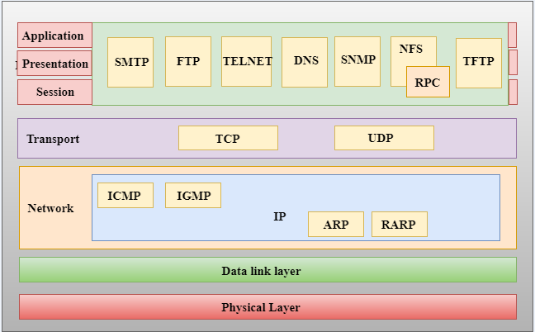
TCP/IP Layers: Basically it has 4 layers which are shown below.
TCP/IP Model
Application Layer
Transport Layer
Internet Layer
Data Link Layer And Physical Layer (Network Access Layer)

Slide 4
Network Access Layer
This layer corresponds to the combination of Data Link Layer and Physical Layer of the OSI model. It looks out for hardware addressing and the protocols present in this layer allows for the physical transmission of data. We just talked about ARP being a protocol of Internet layer, but there is a conflict about declaring it as a protocol of Internet Layer or Network access layer. It is described as residing in layer 3, being encapsulated by layer 2 protocols.

Slide 5
Internet Layer
This layer parallels the functions of OSI’s Network layer. It defines the protocols which are responsible for logical transmission of data over the entire network. The main protocols residing at this layer are :
IP – stands for Internet Protocol and it is responsible for delivering packets from the source host to the destination host by looking at the IP addresses in the packet headers. IP has 2 versions: IPv4 and IPv6. IPv4 is the one that most of the websites are using currently. But IPv6 is growing as the number of IPv4 addresses are limited in number when compared to the number of users.
2. ICMP – stands for Internet Control Message Protocol. It is encapsulated within IP datagram's and is responsible for providing hosts with information about network problems.
3. ARP – stands for Address Resolution Protocol. Its job is to find the hardware address of a host from a known IP address. ARP has several types: Reverse ARP, Proxy ARP, Gratuitous ARP and Inverse ARP.

Slide 6
Transport Layer
This layer is analogous to the transport layer of the OSI model. It is responsible for end-to-end communication and error-free delivery of data. It shields the upper-layer applications from the complexities of data. The two main protocols present in this layer are :
Transmission Control Protocol (TCP) – It is known to provide reliable and error-free communication between end systems. It performs sequencing and segmentation of data. It also has acknowledgment feature and controls the flow of the data through flow control mechanism. It is a very effective protocol but has a lot of overhead due to such features. Increased overhead leads to increased cost.
2. User Datagram Protocol (UDP) – On the other hand does not provide any such features. It is the go-to protocol if your application does not require reliable transport as it is very cost-effective. Unlike TCP, which is connection-oriented protocol, UDP is connectionless.

Slide 7
Application Layer
This layer performs the functions of top three layers of the OSI model: Application, Presentation and Session Layer. It is responsible for node-to-node communication and controls user-interface specifications. Some of the protocols present in this layer are: HTTP, HTTPS, FTP, TFTP, Telnet, SSH, SMTP, SNMP, NTP, DNS, DHCP, NFS, X Window, LPD. Have a look at Protocols in Application Layer for some information about these protocols. Protocols other than those present in the linked article are:
HTTP and HTTPS – HTTP stands for Hypertext transfer protocol. It is used by the World Wide Web to manage communications between web browsers and servers. HTTPS stands for HTTP-Secure. It is a combination of HTTP with SSL(Secure Socket Layer). It is efficient in cases where the browser need to fill out forms, sign in, authenticate and carry out bank transactions.
SSH – SSH stands for Secure Shell. It is a terminal emulations software similar to Telnet. The reason SSH is more preferred is because of its ability to maintain the encrypted connection. It sets up a secure session over a TCP/IP connection.
NTP – NTP stands for Network Time Protocol. It is used to synchronize the clocks on our computer to one standard time source. It is very useful in situations like bank transactions. Assume the following situation without the presence of NTP. Suppose you carry out a transaction, where your computer reads the time at 2:30 PM while the server records it at 2:28 PM. The server can crash very badly if it’s out of sync.

Slide 8
Advantages of TCP/IP Protocol
Layer # | Layer Name | Protocol | Protocol Data Unit | Addressing
5 | Application | Http, SMTP, | Messages | n/a
4 | Transport | TCP/UDP | Segments/ Datagram | Port As
3 | Internet | IP | Packets | IP address
2 | Data Link | Ethernet, Wi-Fi | Frames | MAC Address
1 | Physical | 10 Base T,802.11 | Bits | n/a

Slide 9
Thank You
Name – Taniya Chakraborty Stream – CSE Year – 3rd Semester – 6th
Roll No. – 16800117006 Subject – Computer Network Assignment

